Slide 1
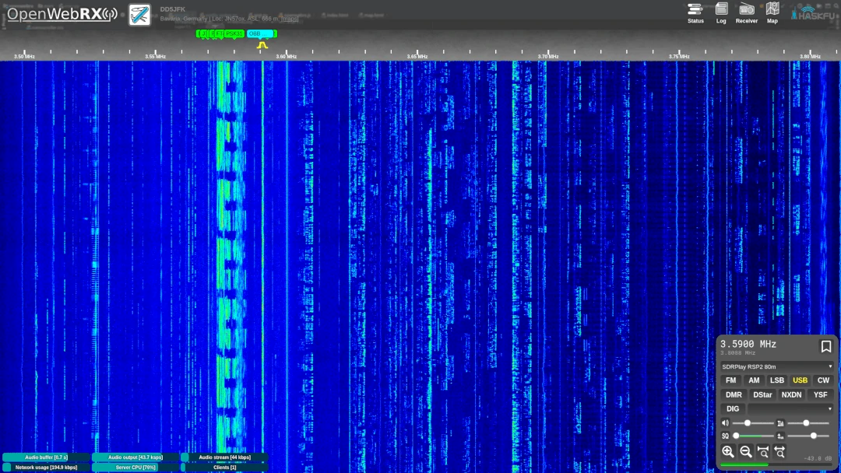

History, Features and Deployment
10/2023 - Stefan Dambeck DC7DS

Slide 2
Agenda
WebSDR / OpenWebRX History
01
How it all began
OpenWebRX(+) Features
02
A walk through OpenWebRX(+) features and decoding capabilities
OpenWebRX(+) Deployment
03
How to roll your own instance of OpenWebRX(+)
OpenWebRX+ Demo
04
Hands-on demonstration

Slide 3
WebSDR / OpenWebRX History
How it all began

Slide 4
History of SDRs and WebSDR
2012
2008
2005
1982
RTL-SDR
First WebSDR
HPSDR
First SDR
Eric Fry discovered that simple DVB-T dongles could be used as a full featured SDR
Pieter-Tjerk de Boer (PA3FWM) created the first WebSDR at the University of Twente
The High Performance SDR project was started in October, 2005 by Phil Covington (N8VB)
Developed by Ulrich L. Rohde (N1UL) for the DoD
owrx
2015
2019
2022
owrx+
OpenWebRX started
OpenWebRX revived
OpenWebRX+
OpenWebRX 1.2.2 and OpenWebRX+ 1.2.33
András Retzler (HA7ILM) started OpenWebRX as his BSc thesis
Jakob Ketterl (DD5JFK) took over the then stale owrx project and added lots of features and greatly improved SDR support
Marat Fayzullin (no ham radio license) forked and massively extended OpenWebRX into OpenWebRX+
Two owrx flavors are available for all relevant platforms (AMD64, arm, arm64) – packages and containers

Slide 5
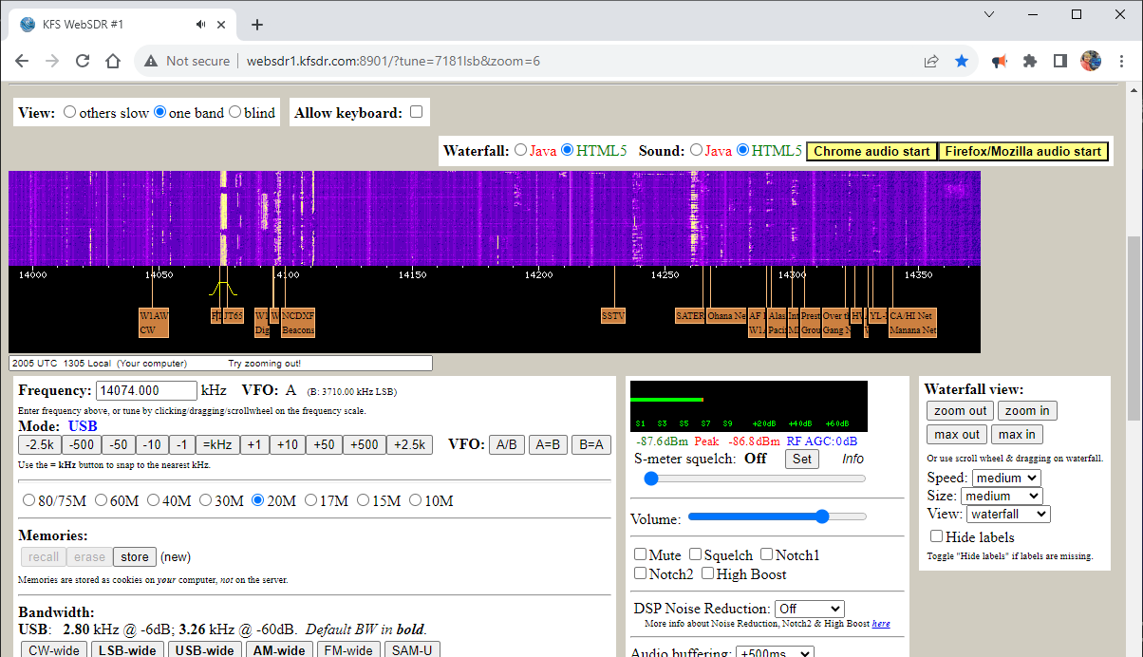
WebSDR by PA3FWM

Slide 6
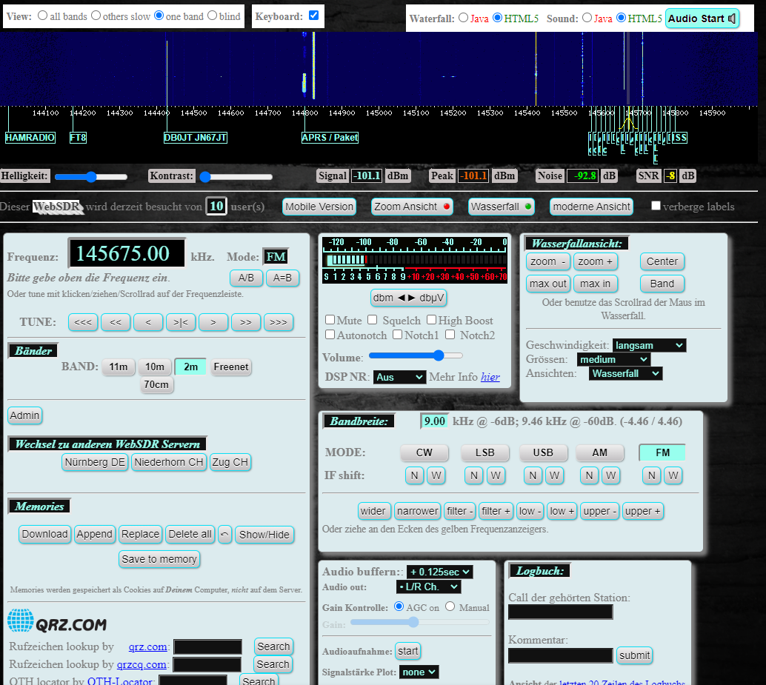
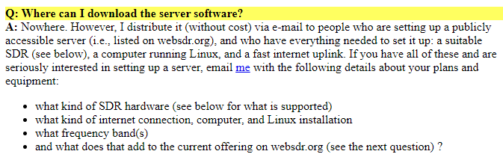
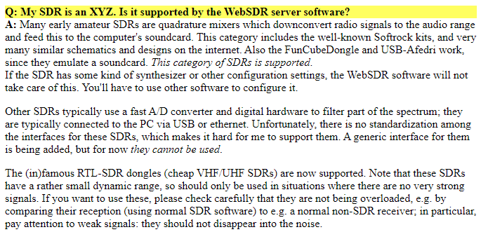
WebSDR by PA3FWM

Slide 7
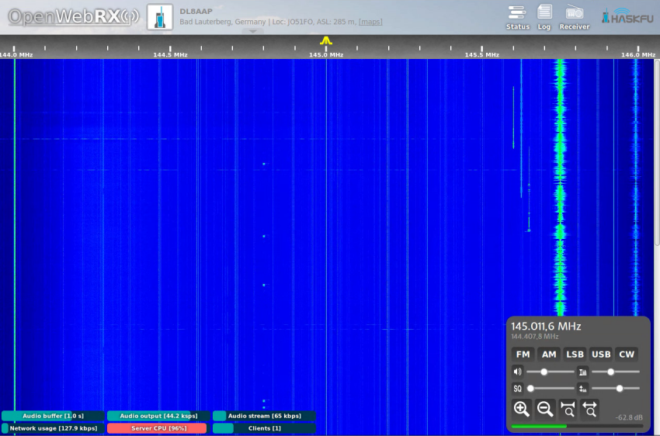
OpenWebRX by HA7ILM
Early OpenWebRX
As of 2016, OpenWebRX had basic features
FM, AM, SSB, CW
Squelch and volume controls
Some waterfall controls
Purely text-based config
Broad SDR support (RTLSDR, Airspy, HPSDR, SDRplay and many more)

Slide 8
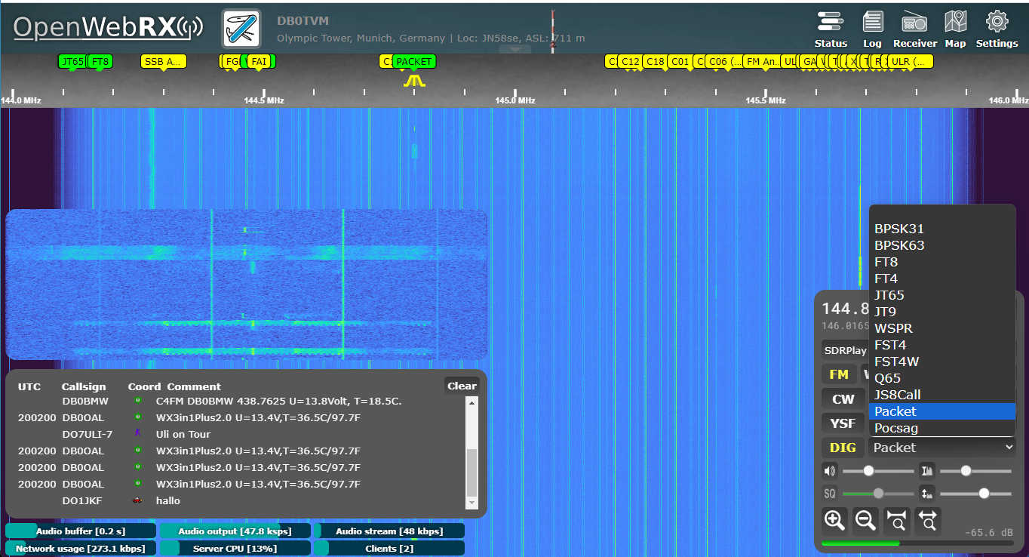
OpenWebRX-Rework by DD5JFK
New OpenWebRX
Jakob DD5JFK greatly enhanced the features of OpenWebRX
Config Web-Gui
Digital Voice (D-Star, C4FM, DMR, NXDN) and Digimode (APRS, FT8/4, WSPR, JS8) decoders integrated into web-ui
Bookmarks and labels
Map view showing decoded signals and their origin (FT8/4, WSPR, JS8, APRS)
Background decoding
Improved SDR support

Slide 9
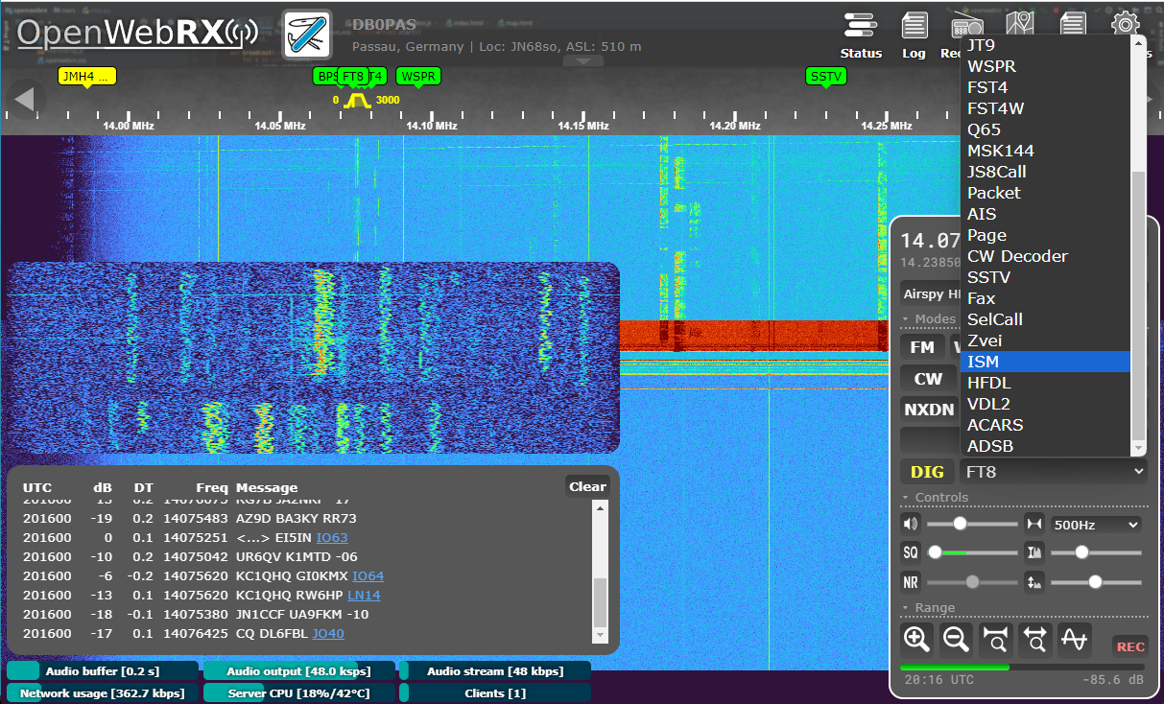
OpenWebRX+ by Marat Fayzullin
OpenWebRX+
Marat Fayzullin forked OpenWebRX into OpenWebRX+ and added lots of decoding capabilities
Enhanced map (OSM) and filters
Lots of additional decoders (SSTV, AIS, CW, Page, Fax, ISM, HFDL/ACARS/ADS-B)
Enhanced Controls and Functions (NR, Rec, spectrum display)
File viewer for received SSTV pics

Slide 10
OpenWebRX(+) Features
A walk through OpenWebRX(+) features and decoding capabilities

Slide 11
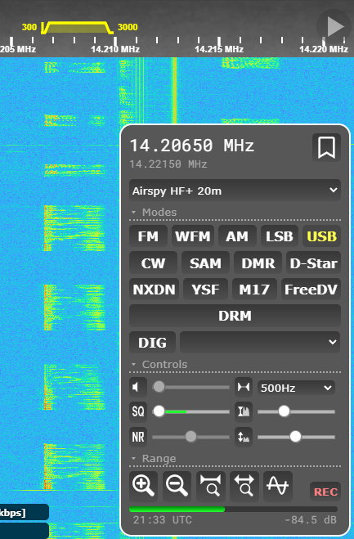
Receive Audio
Receive and demodulate audio
OpenWebRX(+) can receive and demodulate narrowband (FM, AM, SSB, CW) and wideband (WFM, broadcast) transmissions

Slide 12
Receive Digital Voice
Receive and decode digital voice
OpenWebRX(+) can receive and demodulate ham radio digital voice (DV) modes D-Star, C4FM/YSF, DMR, NXDN and M17
Requirements: DV modes that use the proprietary, patented AMBE codec require the use of a codec server plus a hardware AMBE decoder (such as ThumbDV)

Slide 13
Squelch Control
Mute noise and static
OpenWebRX(+) has a built in squelch function to mute noise and static based on signal strength

Slide 14
Waterfall controls
Setup display and bandwidth
The waterfall display in OpenWebRX(+) is controllable via multiple slider controls and buttons

Slide 15
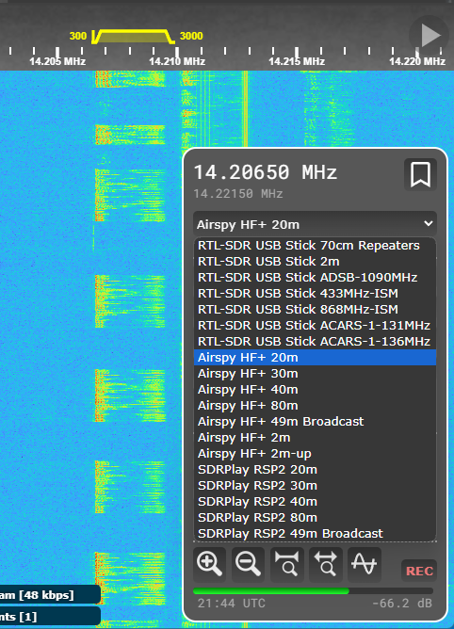
Receive Profiles
Choose device and band
OpenWebRX(+) supports the simultaneous use of many SDRs and bands – just choose device and band via the profile dropdown box

Slide 16
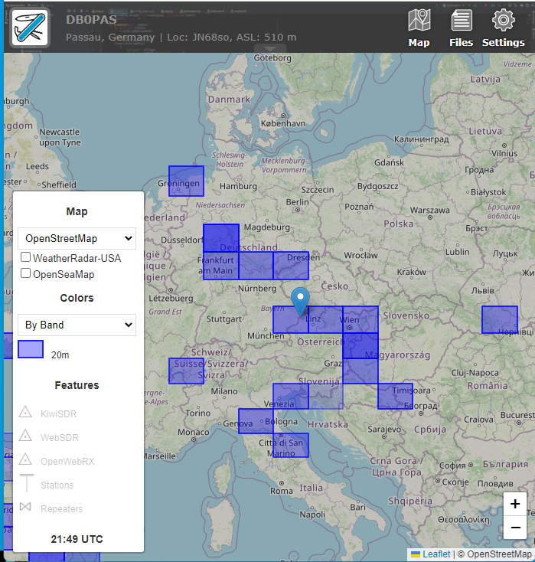
Map view
Map
OpenWebRX(+) has an integrated map view using Google maps or OpenStreetMaps to show positions of received stations (e.g. FT8 or APRS/Packet decodes)

Slide 17
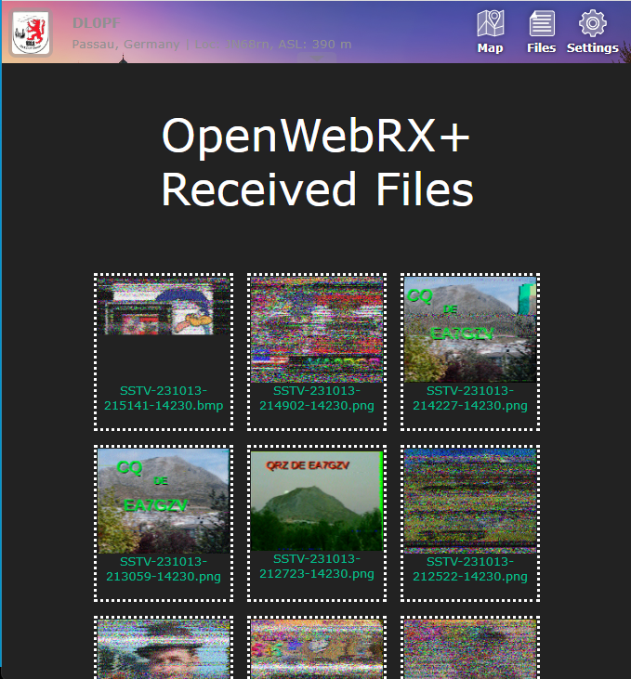
Received Files
Received Files
OpenWebRX+ has an integrated file viewer for received SSTV pictures

Slide 18
Audio Recorder
OpenWebRX+ supports live recording of received transmissions to a local .mp3 file using browser-based functions
Record Audio

Slide 19
Noise Reduction
OpenWebRX+ supports configurable noise reduction on the received signals
Noise Reduction

Slide 20
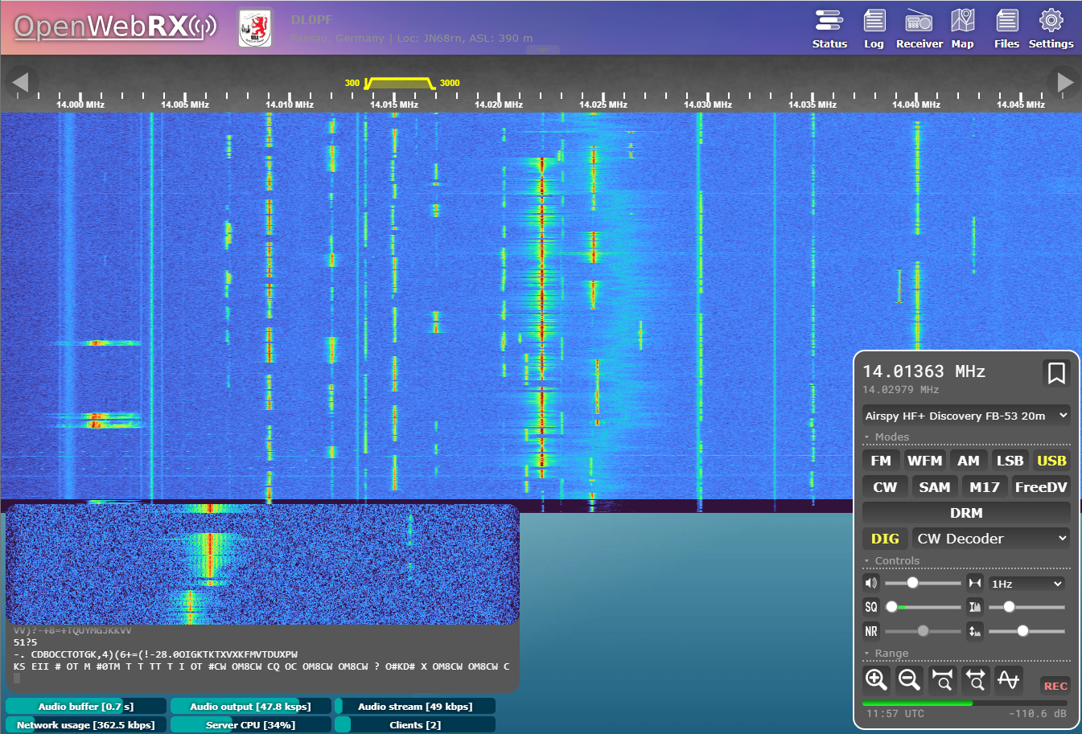
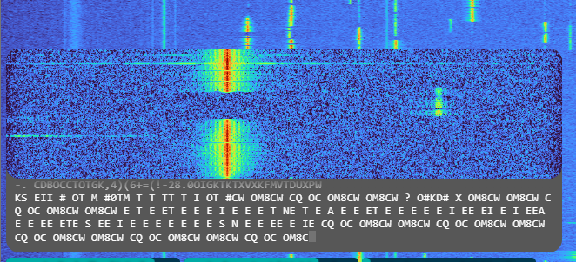
cw decoder
OpenWebRX+ has an integrated cw decoder
cw

Slide 21
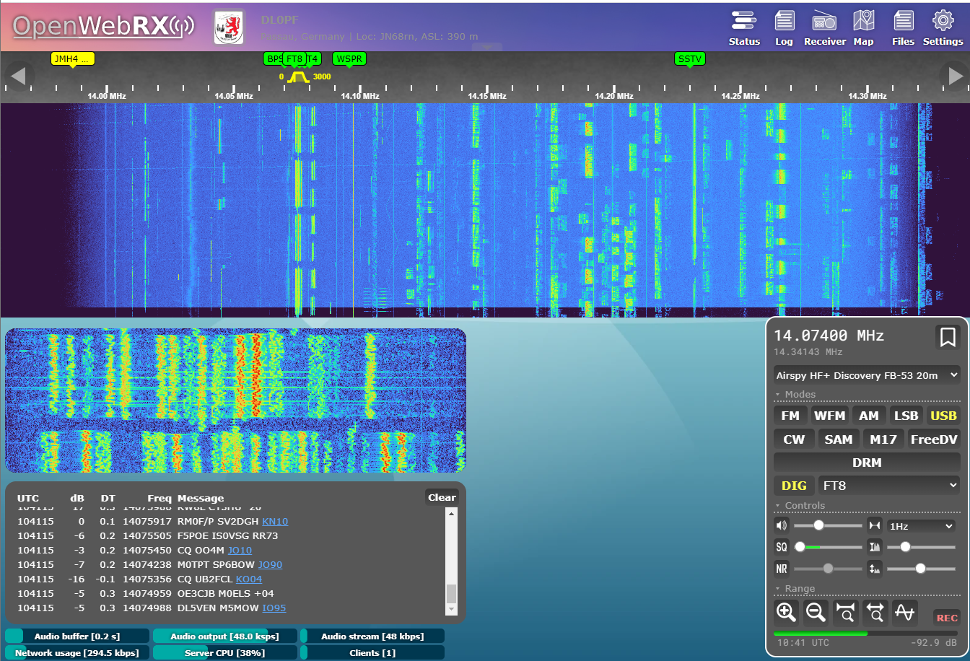
Digimodes: FT8
OpenWebRX(+) supports realtime FT8 decoding. Spots are shown on the internal map and uploaded to pskreporter
FT8

Slide 22
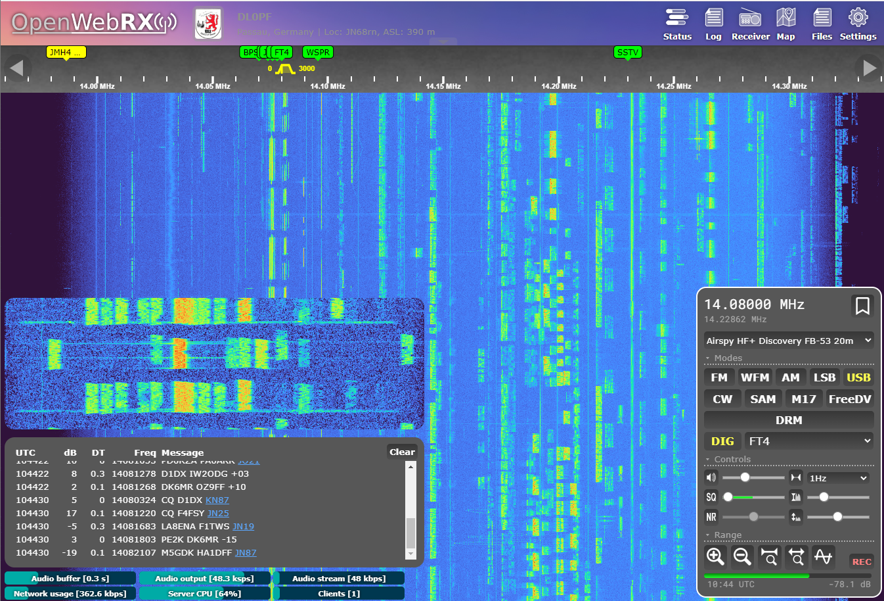
Digimodes: FT4
OpenWebRX(+) supports realtime FT4 decoding. Spots are shown on the internal map and uploaded to pskreporter
FT4

Slide 23
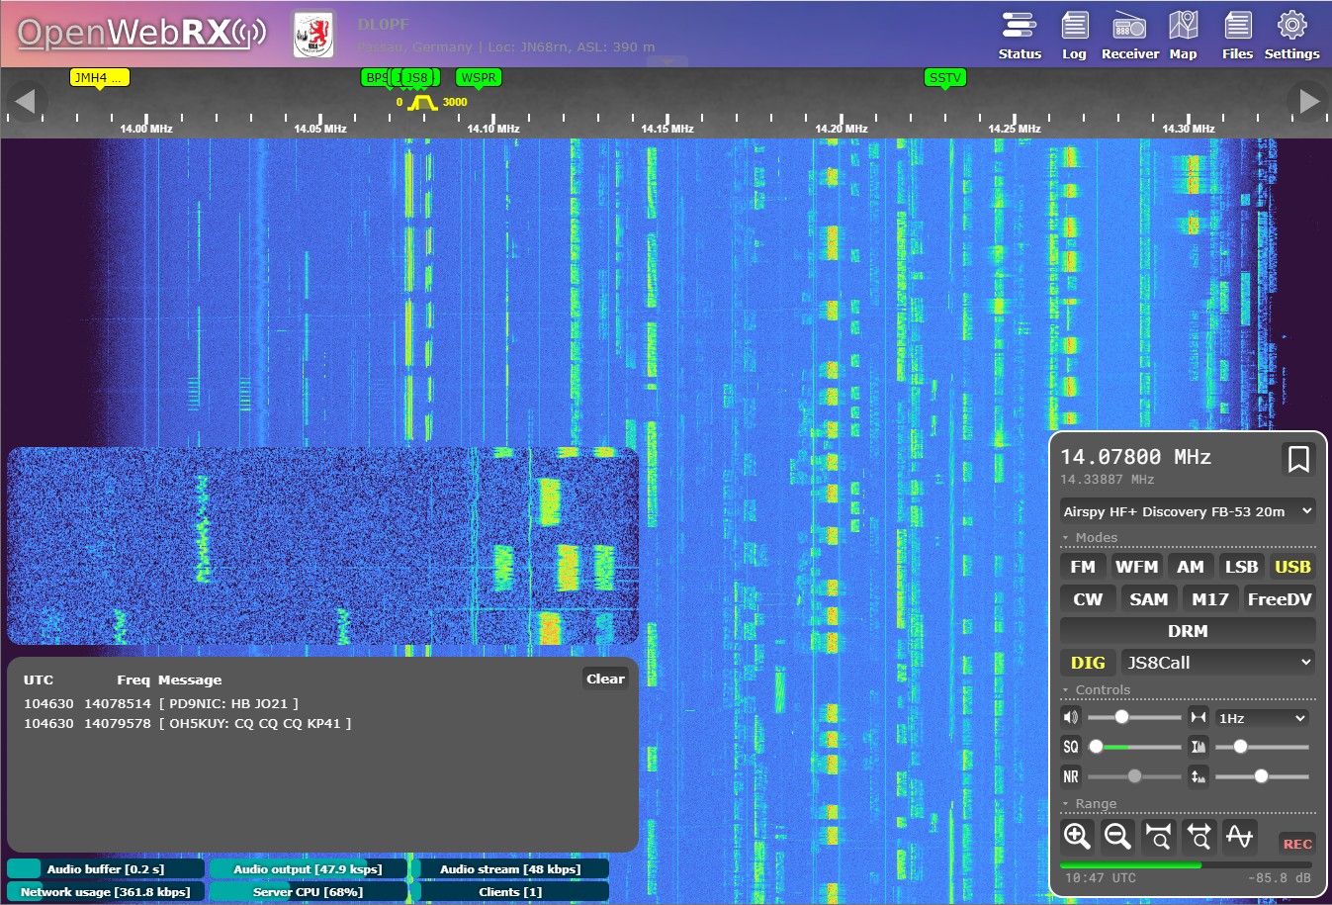
Digimodes: JS8Call
OpenWebRX(+) supports realtime JS8Call decoding. Spots are shown on the internal map and uploaded to pskreporter
JS8Call

Slide 24
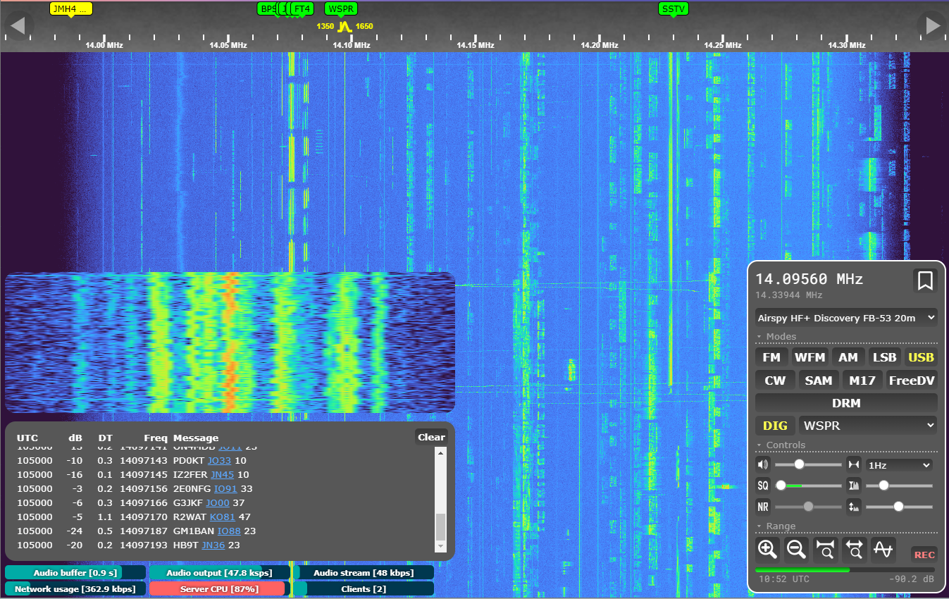
Digimodes: WSPR
OpenWebRX(+) supports realtime WSPR decoding. Spots are shown on the internal map and uploaded to wsprnet.org
WSPR

Slide 25
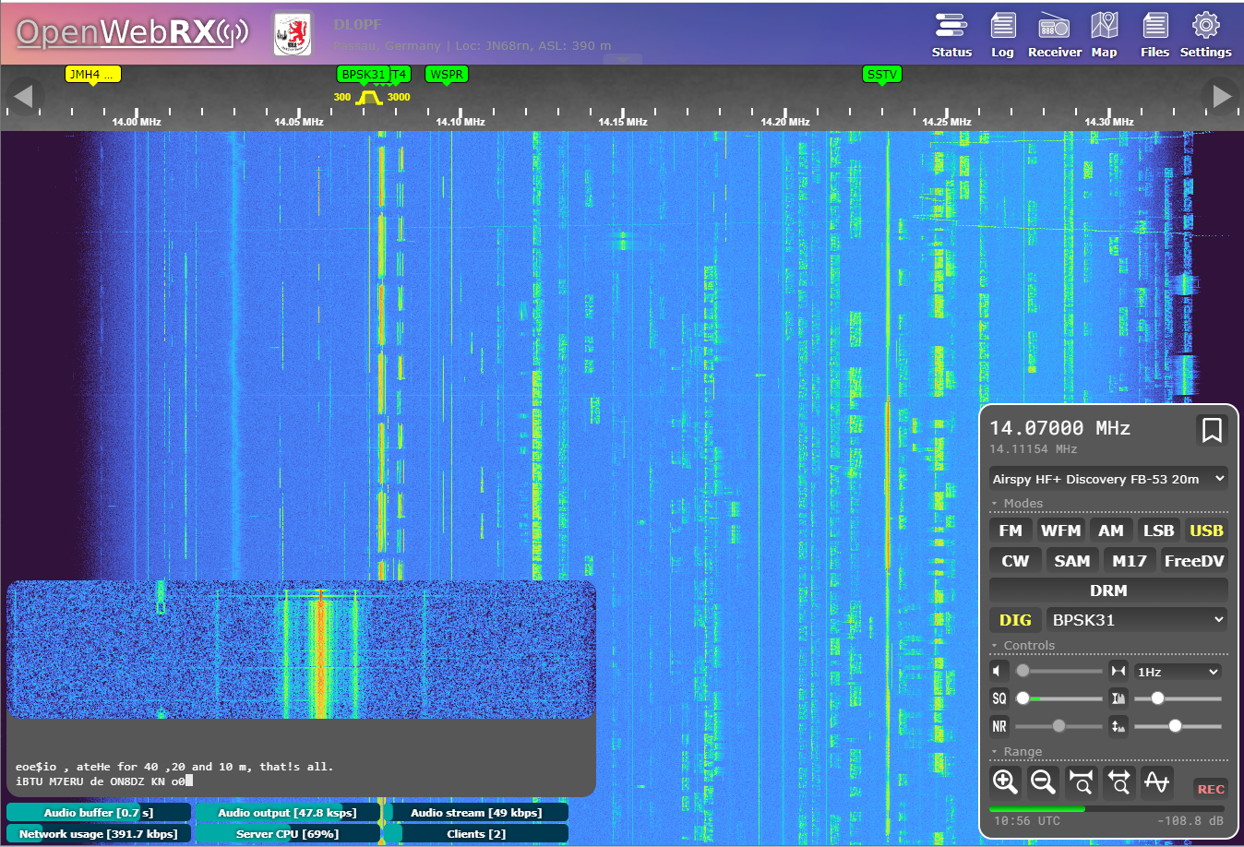
Digimodes: BPSK31
OpenWebRX(+) supports realtime BPSK31 decoding. Decoded text is shown in the receiver panel
BPSK31

Slide 26
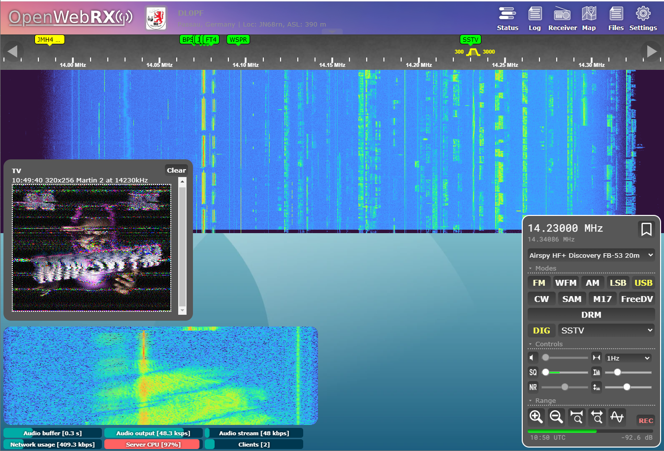
Digimodes: SSTV
OpenWebRX+ supports realtime SSTV decoding. Received images are shown on the “Files” subpage
SSTV

Slide 27
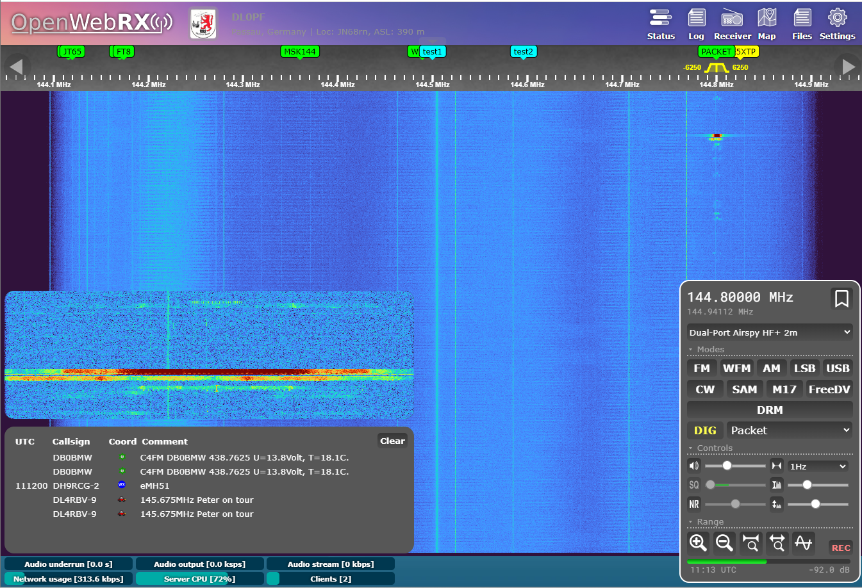
Digimodes: Packet(I)
OpenWebRX(+) supports realtime APRS AFSK 1K2 decoding. Received stations are shown on the internal map and uploaded to aprs-is
AFSK 1K2

Slide 28
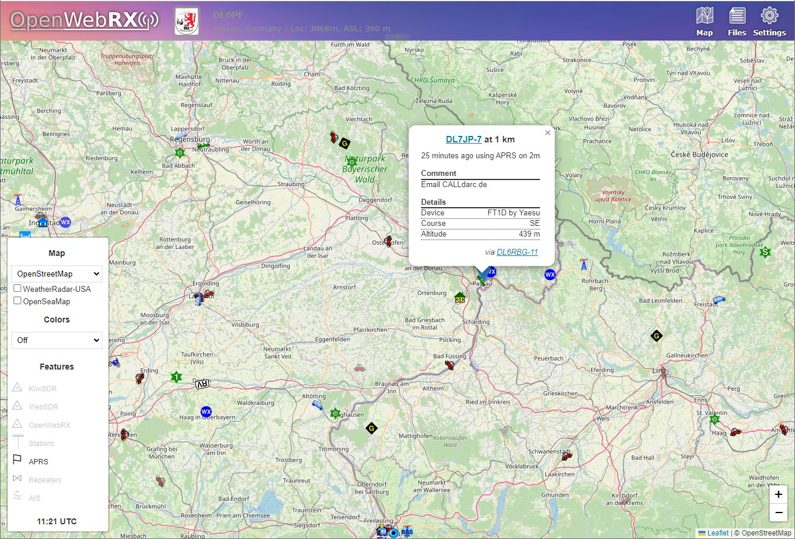
Digimodes: Packet(II)
OpenWebRX(+) supports a map view of received APRS stations
AFSK 1K2

Slide 29
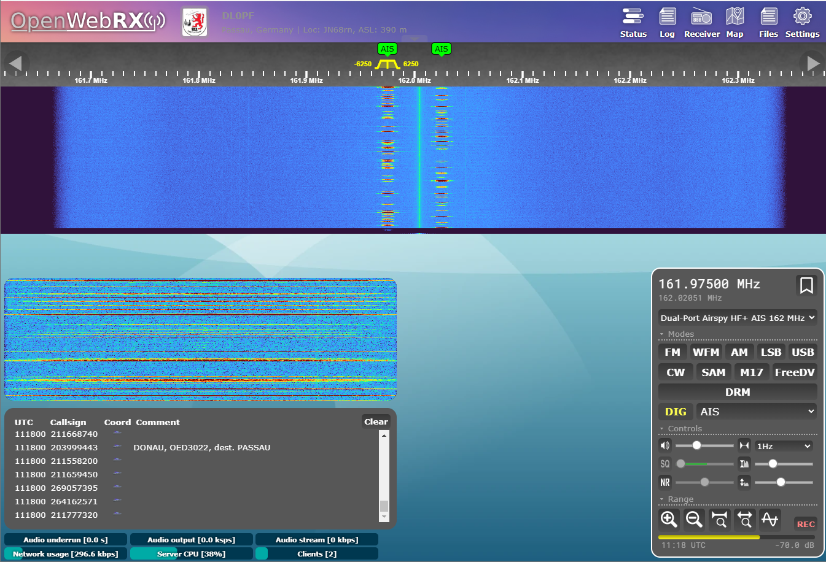
Digimodes: AIS(I)
OpenWebRX+ supports realtime AIS decoding. Received stations are shown on the internal map
AIS

Slide 30
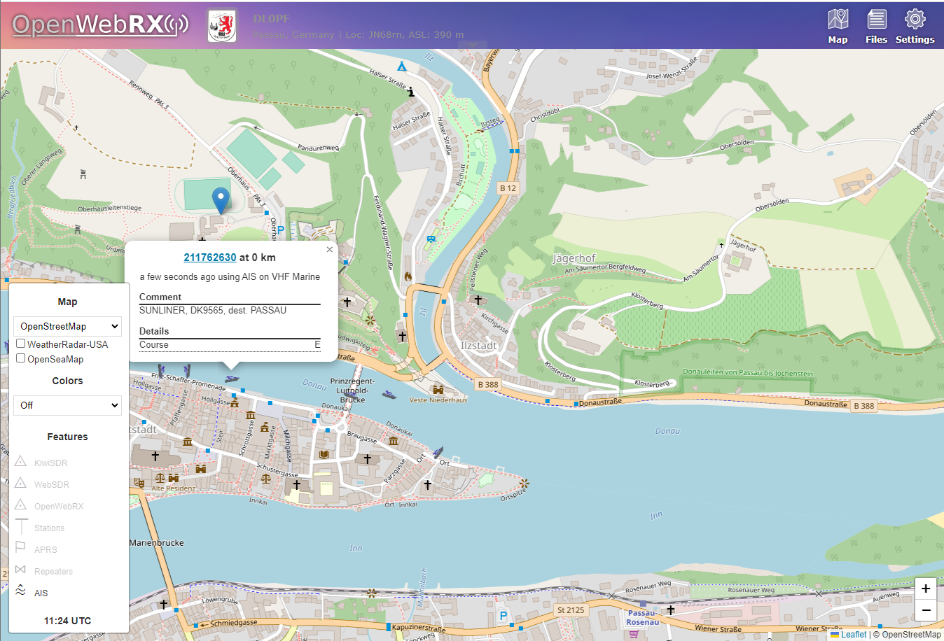
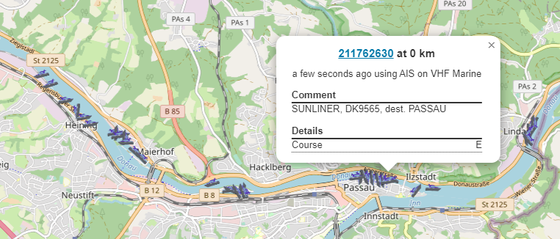
Digimodes: AIS(II)
OpenWebRX+ supports a map view of received AIS stations
AIS

Slide 31
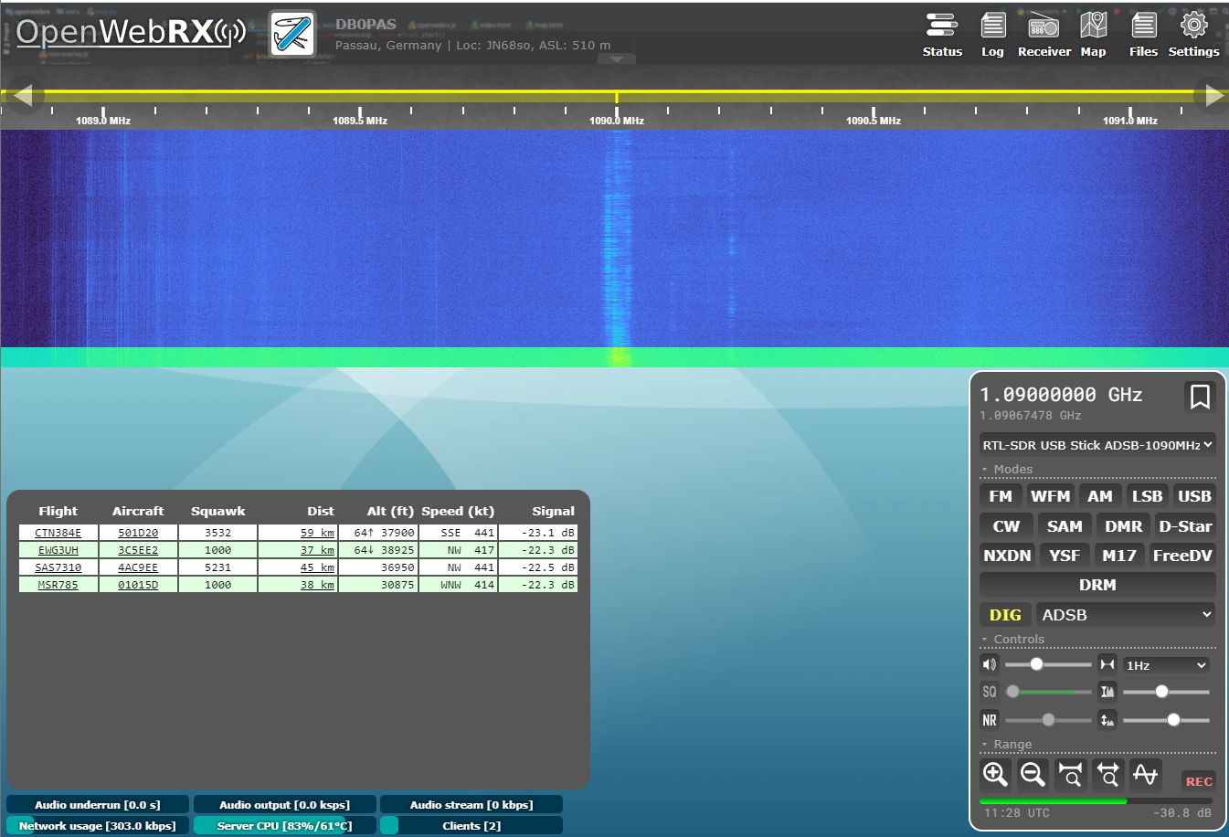
Digimodes: ADSB(I)
OpenWebRX+ supports realtime ADSB decoding. Received stations are shown on the internal map
ADSB

Slide 32
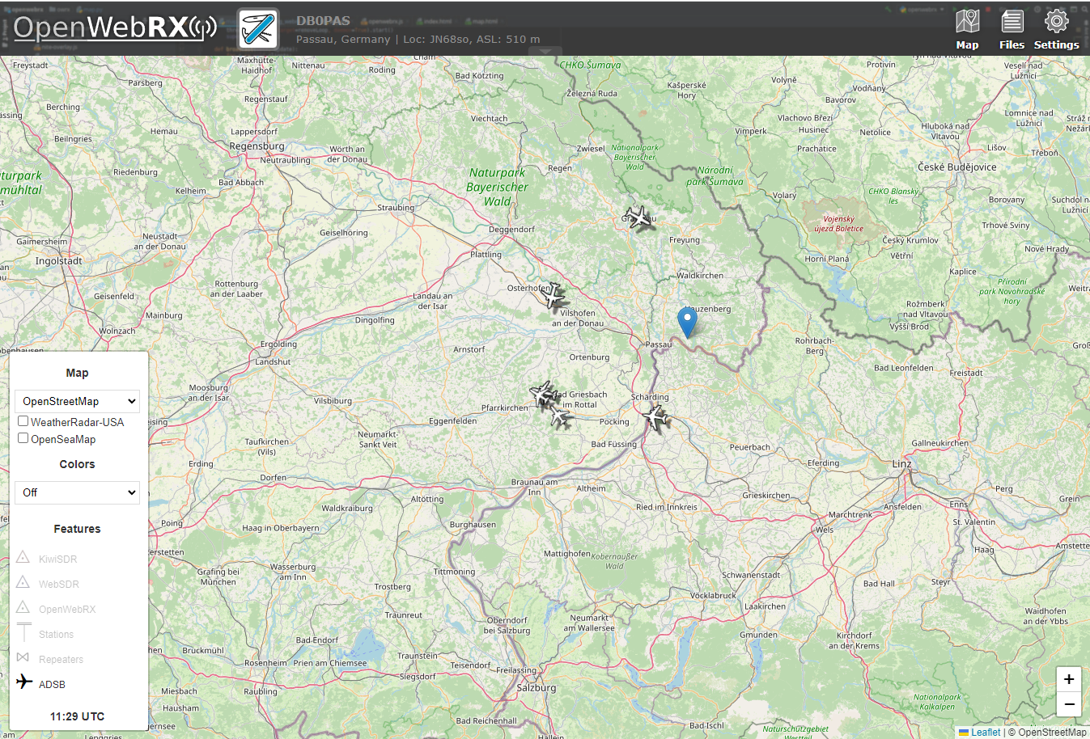
Digimodes: ADSB(II)
OpenWebRX+ supports a map view of received ADSB stations
ADSB

Slide 33
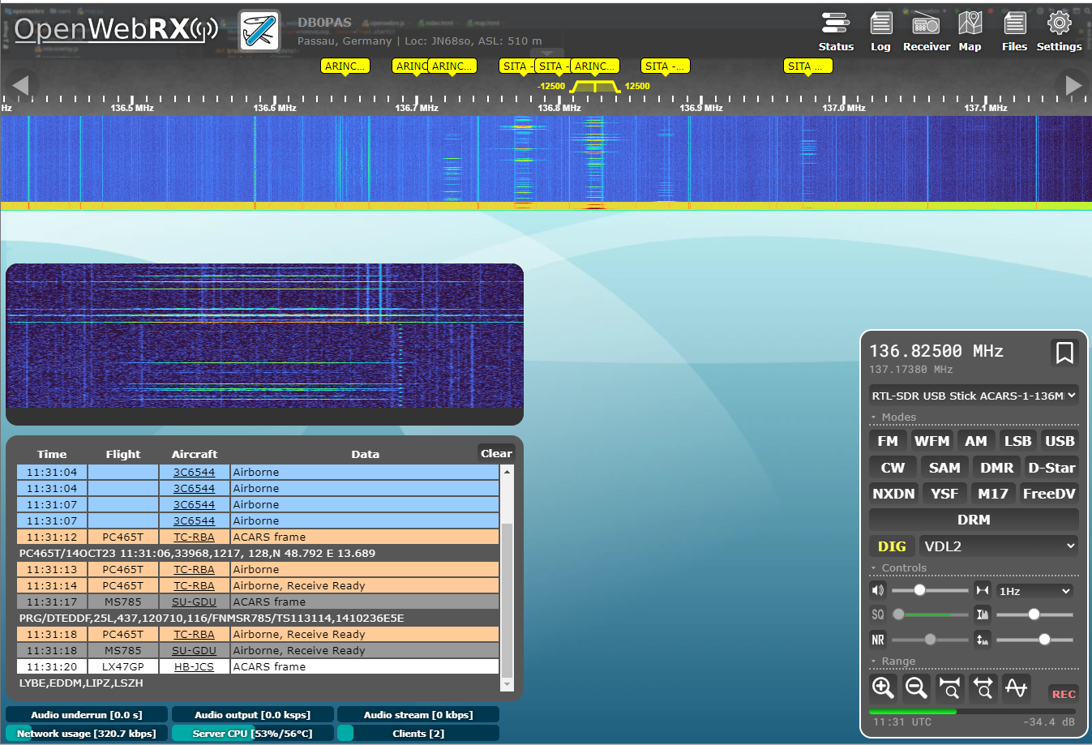
Digimodes: VDL2/ACARS
OpenWebRX+ supports realtime VDL2/ACARS and HFDL decoding on VHF airband. Decoded messages are shown in the receiver panel
VDL2/ACARS

Slide 34
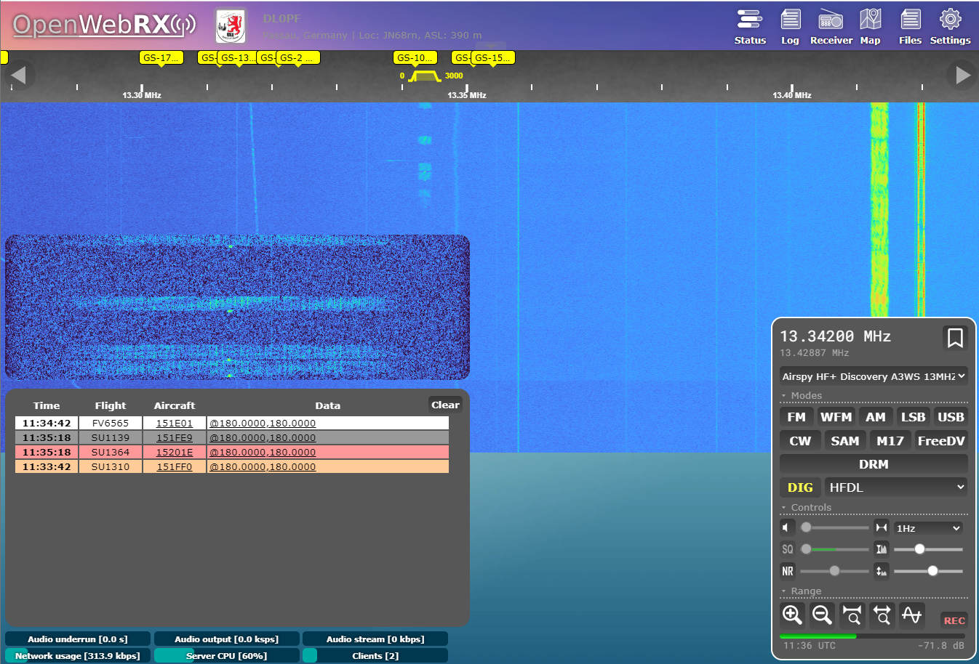
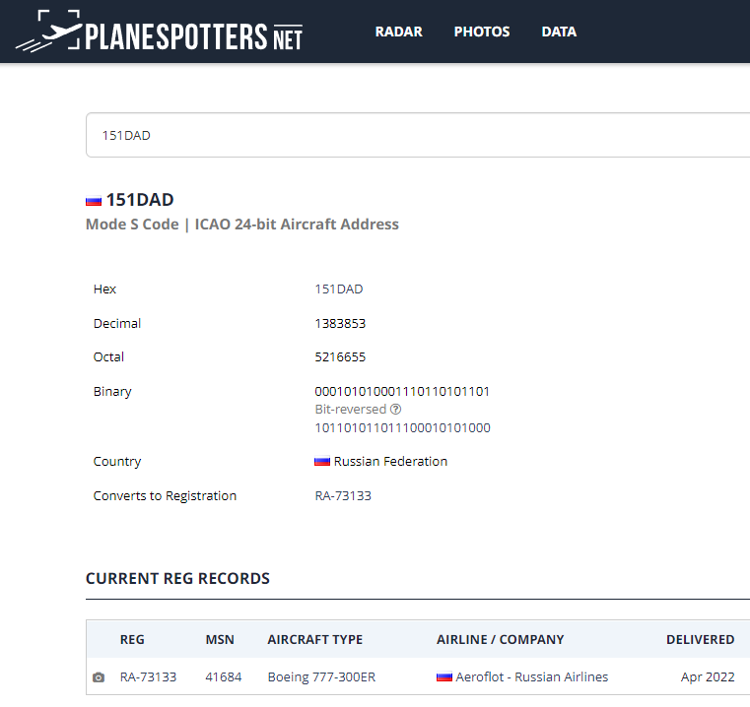
Digimodes: HFDL
OpenWebRX+ supports realtime HFDL decoding on 13MHz airband. Decoded messages are shown in the receiver panel
HFDL

Slide 35
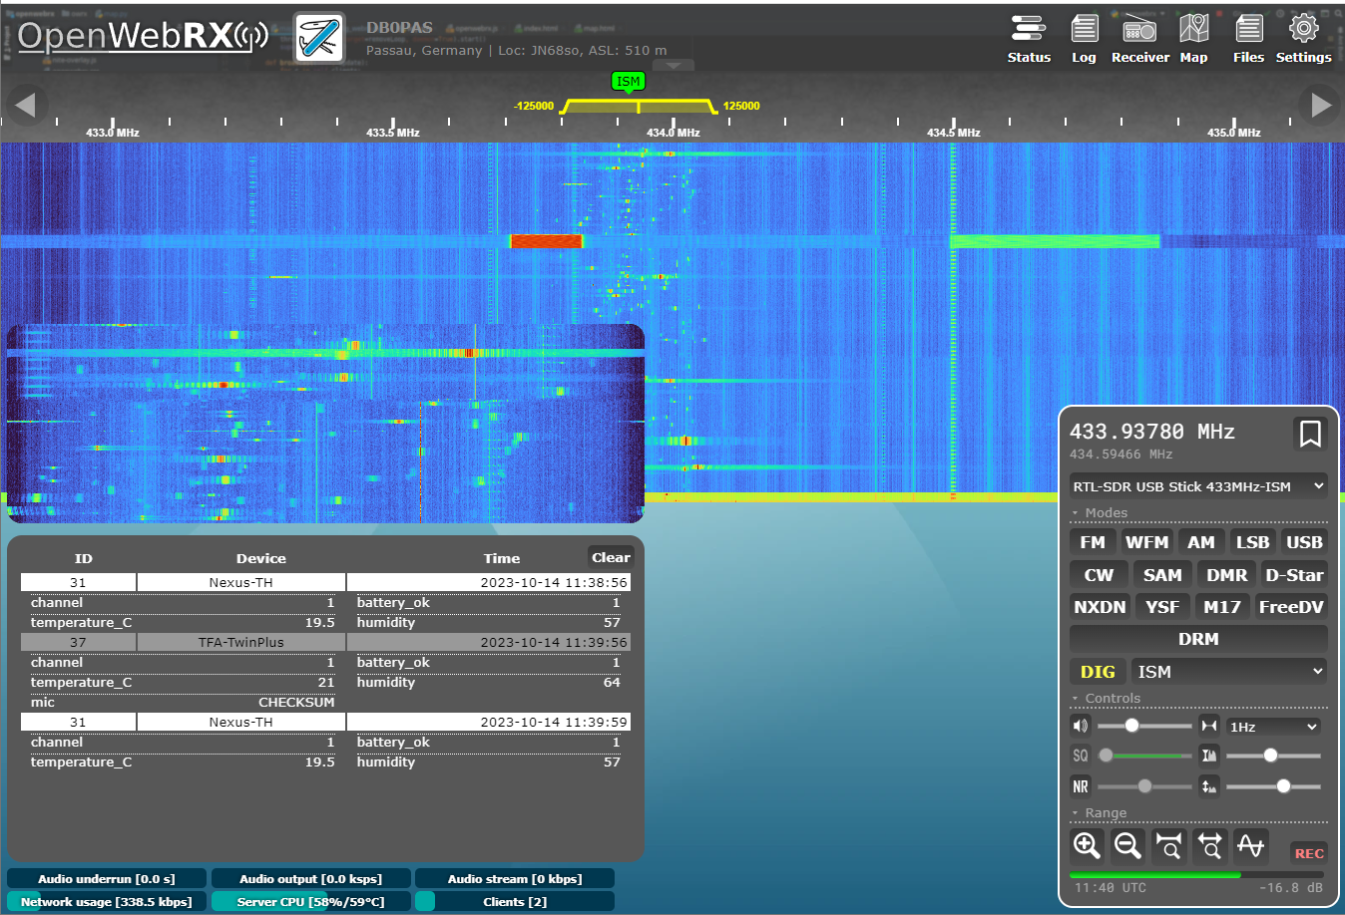
Digimodes: ISM
OpenWebRX+ supports realtime ISM band decoding on 433 MHz. Decoded messages are shown in the receiver panel
ISM

Slide 36
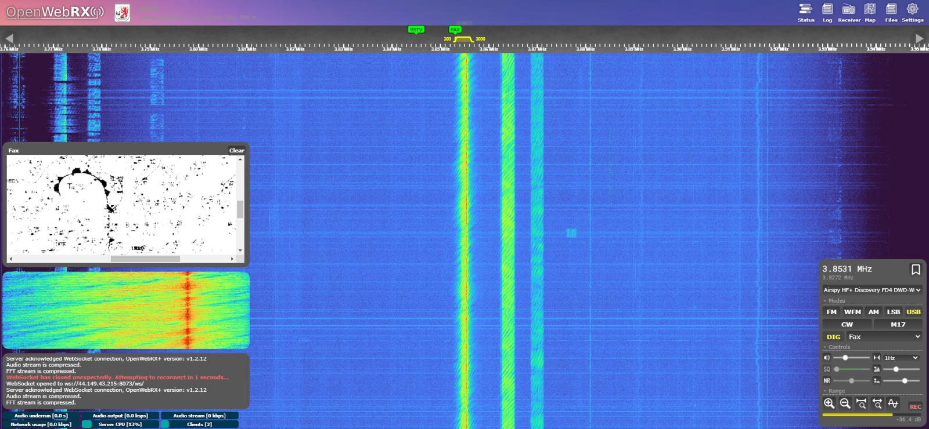
Digimodes: FAX
OpenWebRX+ supports realtime FAX decoding. Decoded images are shown in the receiver panel and are accessible via “Files”
FAX

Slide 37
Digimodes
Additional Digimodes are supported
MSK144
RTTY
JT65
JT9
FST4 / FST4W
Q65
Pagers
SelCall / ZVEI

Slide 38
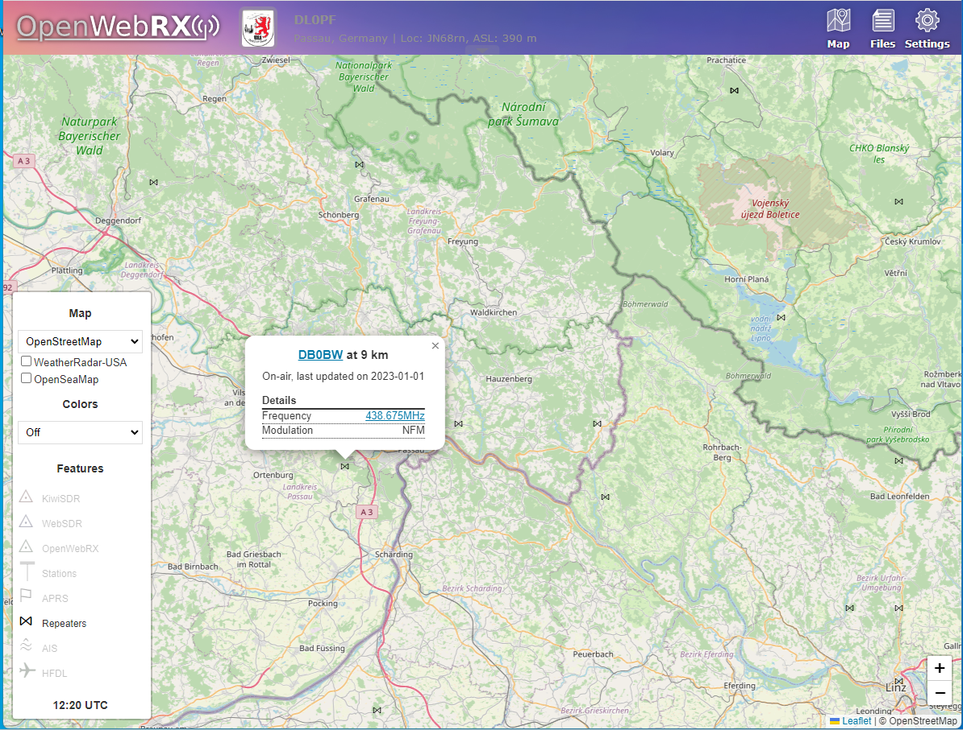
Map: Repeaters
OpenWebRX+ supports a map view of nearby repeaters (via repeaterbook)
Repeaters

Slide 39
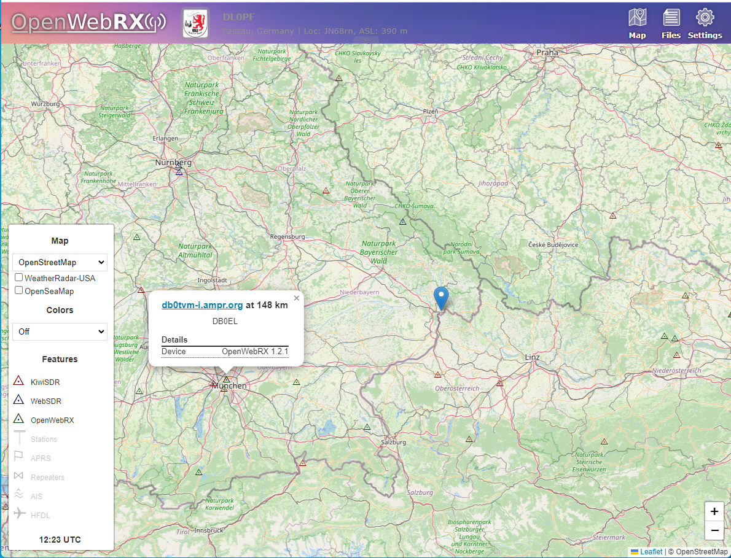
Map: WebSDRs
OpenWebRX+ supports a map view of WebSDRs: KiwiSDR, WebSDR, OpenWebRX
WebSDRs

Slide 40
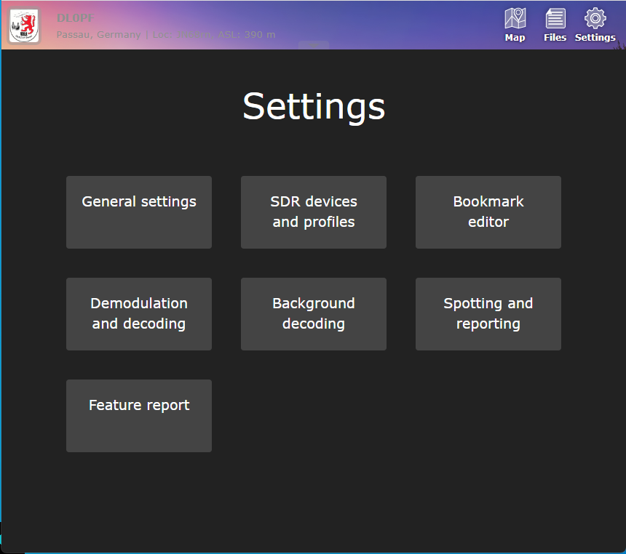
Settings Gui
Settings
OpenWebRX(+) has an integrated Web-based settings editor that enables easy configuration of station settings, SDR devices and profiles as well as decoding settings

Slide 41
OpenWebRX(+) Deployment
How to roll your own instance of OpenWebRX(+)

Slide 42
OpenWebRX(+) platform options
Standard PC
Single Board Computer (SBC)
Just use Linux (Debian, Ubuntu) and install OpenWebRX(+) packages
SBCs like RaspberryPi or OrangePi can be used. There are readily built RasPi images for OpenWebRX and OpenWebRX+ for an easy, quick start
Virtual Machine
Docker container
Same as PC, just using a Linux virtual machine w/ SDRs by USB passthrough or network
There are readily built Docker containers for both OpenWebRX and OpenWebRX+, usable on any kind of platform (PC, VM, SBC)

Slide 43
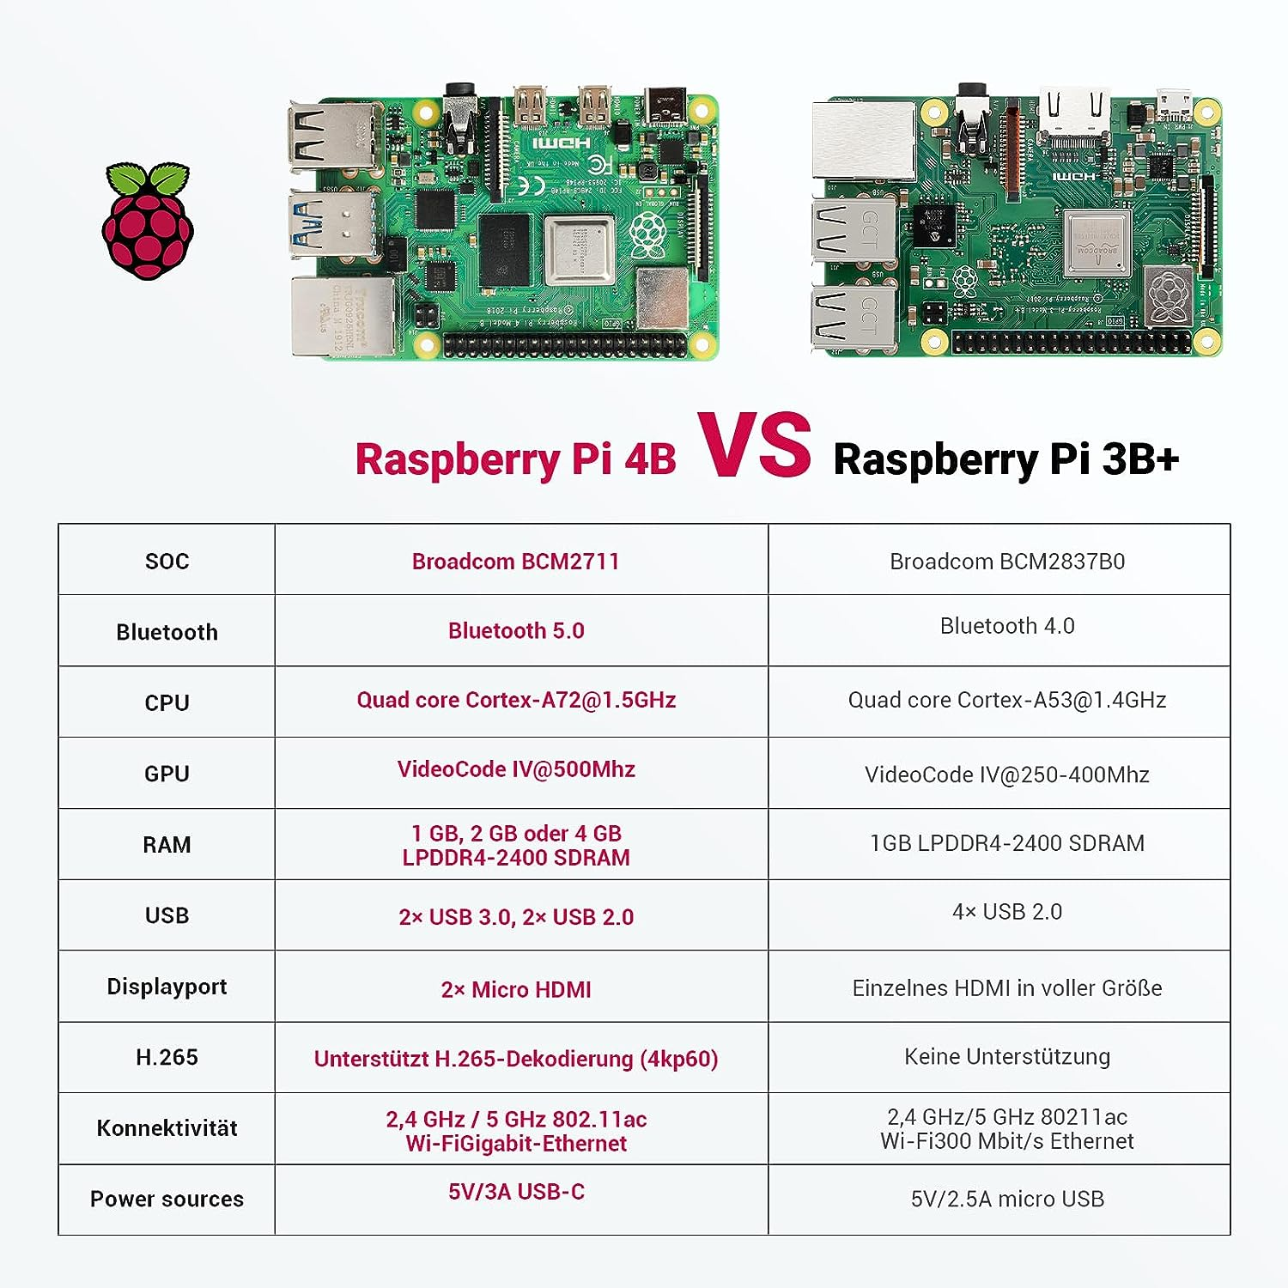
Raspberry Pi 4B
As of Q4/2023, the gold-standard of single board computers
Good starting point for OpenWebRX(+)
Ready built images are available
Powerful enough for 1-2 SDRs and a small amount of users
priced at ~50,-€ incl. tax

Slide 44
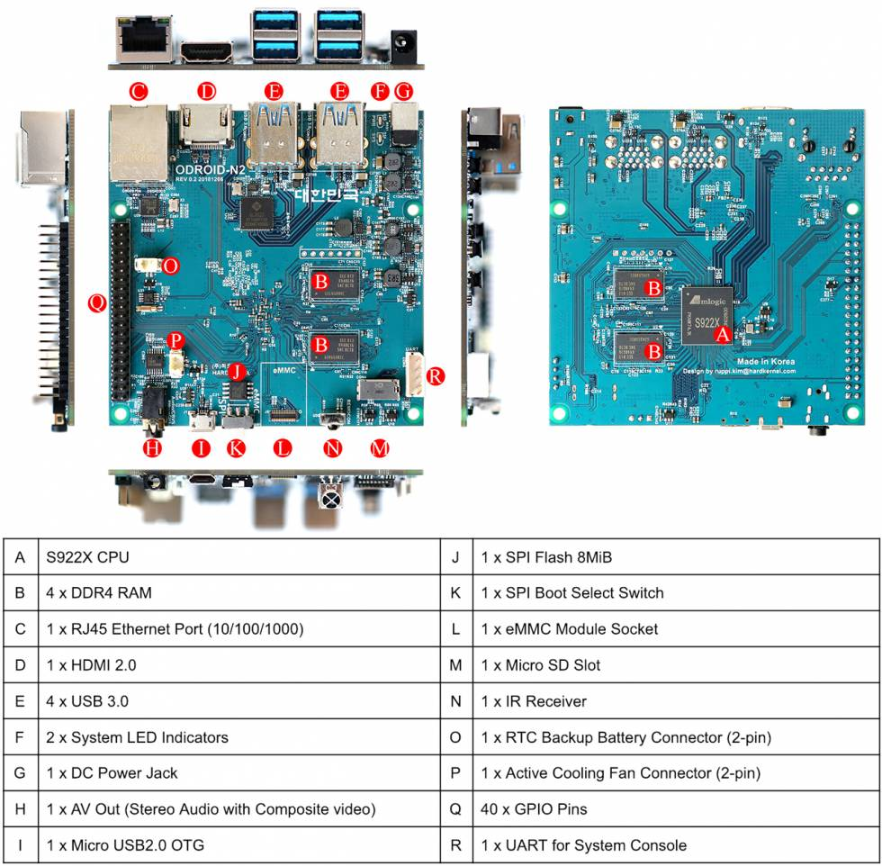
ODROID N2(+)
As of Q4/2023, still one of the most powerful single board computers (though it was released 2019)
No readily built image available, but docker ARM64 build can be used
2 – 2.5 times the performance of Raspberry Pi 4B
priced at ~100,-€ incl. tax

Slide 45
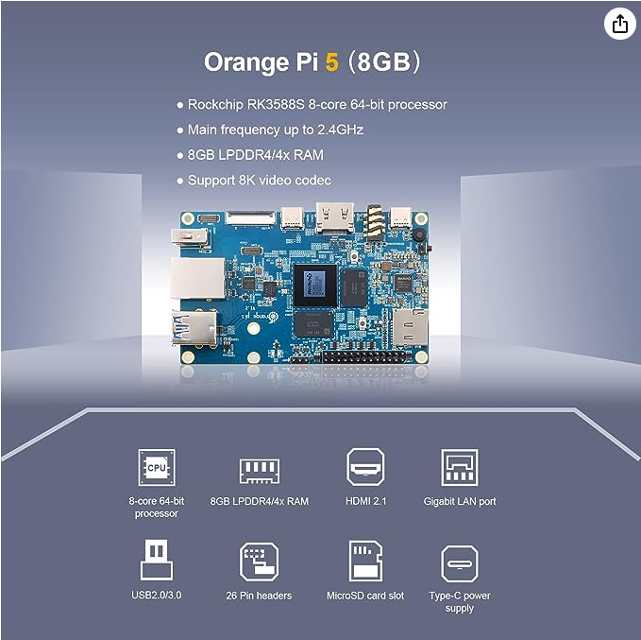
Orange Pi 5
As of Q4/2023, one of the most powerful single board computers
No readily built image available, but docker ARM64 build can be used
2 – 2.5 times the power of odroid N2+
3.5 – 4 times the performance of RasPi 4B
Even more powerful that brand-new RasPi 5 (no details yet)
priced at ~100,-€ + tax

Slide 46
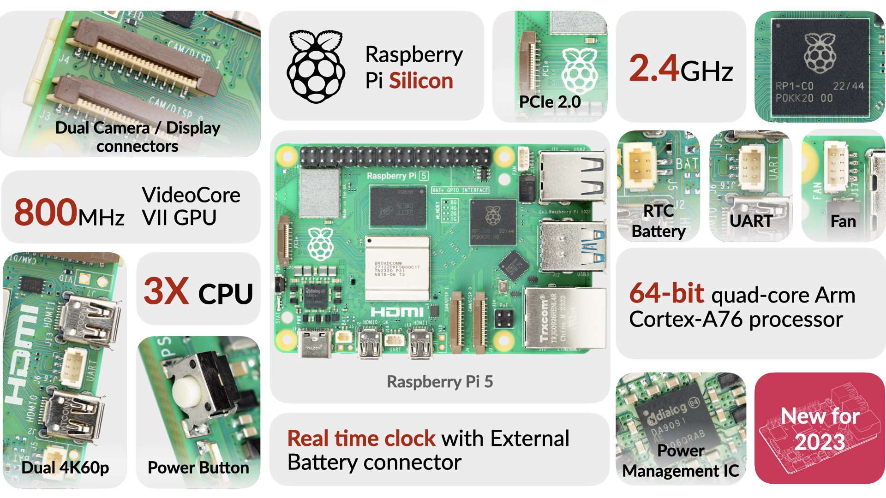
Raspberry Pi 5
RTM Q4/2023, the gold standard in single board computers is getting a massive upgrade
Perfect starting point for OpenWebRX(+)
Ready built images are available
Performance should at level of ODROID N2+
priced at ~80,-€ incl. tax

Slide 47
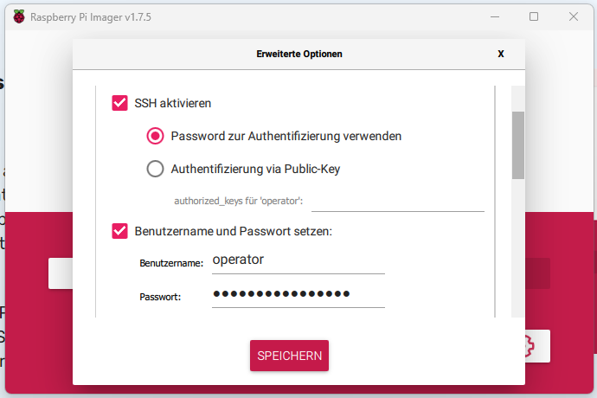
RaspberryPi install

Slide 48
Package install
Manual installation via packages (as root)
wget -O - https://luarvique.github.io/ppa/openwebrx-plus.gpg | gpg --dearmor -o /etc/apt/trusted.gpg.d/openwebrx-plus.gpg
echo "deb [signed-by=/etc/apt/trusted.gpg.d/openwebrx-plus.gpg] https://luarvique.github.io/ppa/ubuntu ./" > /etc/apt/sources.list.d/openwebrx-plus.list
apt update
wget -O - https://repo.openwebrx.de/debian/key.gpg.txt | gpg --dearmor -o /usr/share/keyrings/openwebrx.gpg
echo "deb [signed-by=/usr/share/keyrings/openwebrx.gpg] https://repo.openwebrx.de/ubuntu/ jammy main" > /etc/apt/sources.list.d/openwebrx.list
apt update
apt install openwebrx

Slide 49
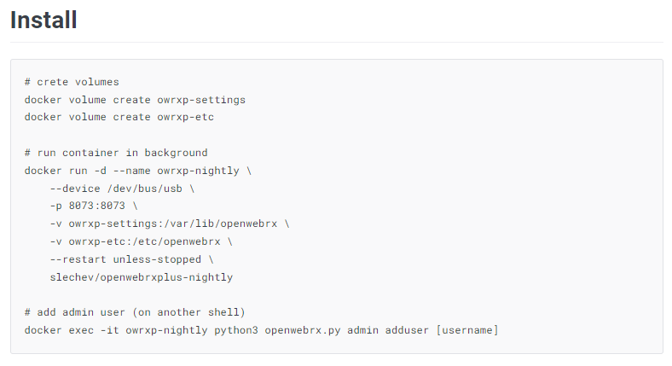
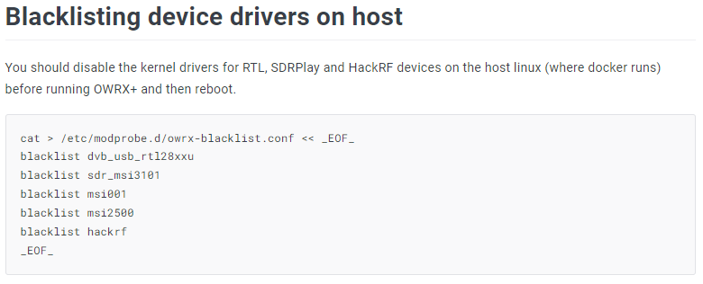
Docker install

Slide 50
OpenWebRX+ Demo

Slide 51
OpenWebRX(+) Links
Central source of information
OpenWebRX:
https://openwebrx.de/
https://github.com/jketterl/openwebrx/wiki
OpenWebRX+: https://github.com/luarvique/ppa
Project Websites
How to find public WebSDRs
Receiverbook: https://www.receiverbook.de/
Public KiwiSDRs: http://kiwisdr.com/public/
Public WebSDRs
http://websdr.org/
SDRs usable with OpenWebRX(+)
Receiver Lists
Airspy: https://airspy.com/
RTLSDR: https://www.nooelec.com/store/sdr.html
https://www.rtl-sdr.com/v4/
SDRplay: https://www.sdrplay.com/
HackRF
https://greatscottgadgets.com/hackrf/
PlutoSDR (Analog Adalm Pluto):
https://www.mouser.de/new/analog-devices/adi-adalm-pluto/
…
SDRs
Contact authors and other OpenWebRX users
OpenWebRX Group: https://groups.io/g/openwebrx
OpenWebRX(+) Telegram chat: https://t.me/openwebrx_chat
Community

Slide 52
Thanks for watching!
And now…
get started!

